Slide 1
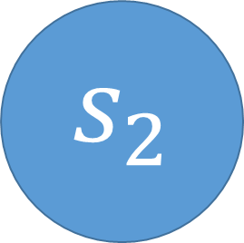
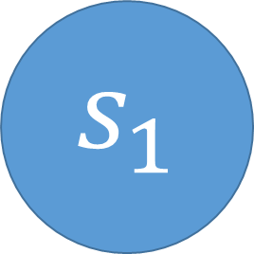
a
reward 5
prob 0.5
a
c
$$s_{1}$$
$$s_{2}$$
reward 5
prob 0.5
reward -1
prob 1
reward 10
prob 1
b

